Slide 1

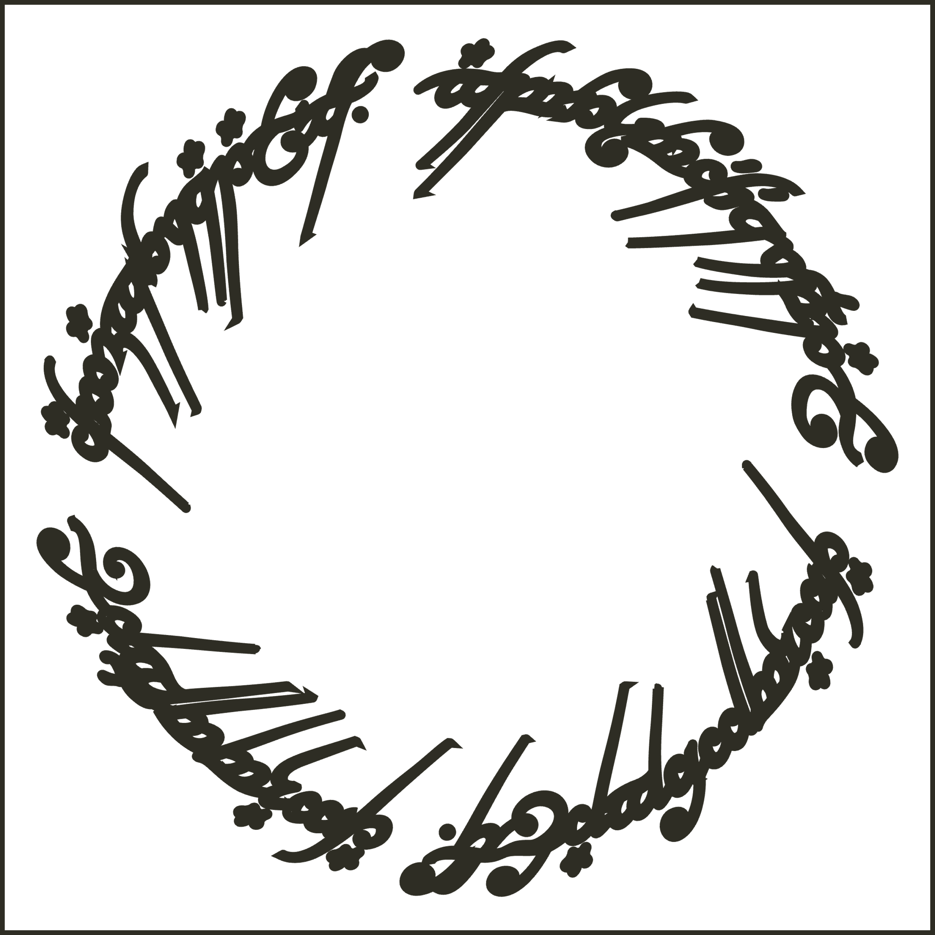


ISSS606 Social Analytics
"My Precious!!" To Analyse the Lord of the Rings Characters Dynamic Connections

Slide 2
Why "The Lord of the Rings" ? ​
The "Lord of the Rings" books and movies offer rich material for Analytics .
Dedicated Fanbase
"The Lord of the Rings" boasts a large and engaged fanbase across various online platforms, providing ample data for analysis.
Deep Lore and Worldbuilding:
J.R.R. Tolkien's rich lore offers abundant topics for analysis, from Middle-earth history to cultural intricacies.
Cinematic Impact
Peter Jackson's films have left a significant mark on popular culture, making discussions around the movies valuable for social analytics.
Universal Themes
The story's timeless themes resonate globally, fostering discussions that transcend cultural boundaries and making it an ideal subject for analysis.

Slide 3
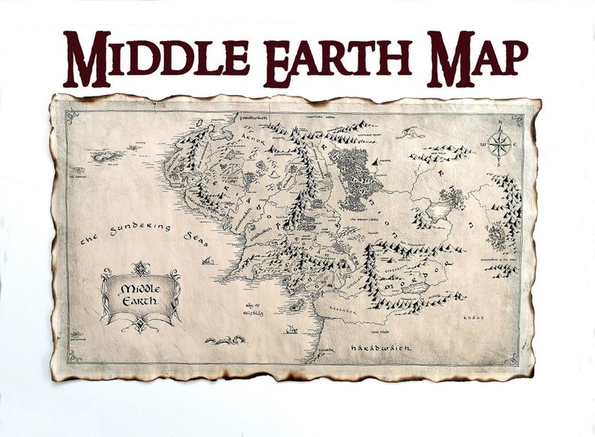
Table of contents
Project Overview
02
Dataset Description
01
Approach & Findings
04
Reference
03
Project Statement(Vision) & Objectives
Exploratory Network Analysis
Social Influence
Community Detection
Sentiment Analysis

Slide 4
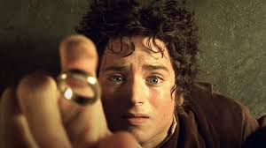
Project Overview and Background
01
Central Character and Plot: The story revolves around Frodo Baggins, a Hobbit entrusted with the task of destroying the One Ring to defeat the dark lord Sauron and restore peace to Middle-earth.
Imaginary Social Web: The scripts create a detailed and interconnected social network, showcasing the relationships between characters.
Character Introduction: Over the course of the three movies, a multitude of characters are introduced, each with their own intricate connections and personal arcs.
Movies in the Trilogy: The trilogy includes "The Fellowship of the Ring," "The Two Towers," and "The Return of the King," each contributing to the overarching narrative.
Themes: The films explore themes of friendship, sacrifice, courage, and the battle between good and evil.
Rich Narrative and World-Building: The series is known for its deep, immersive storytelling and expansive world-building, bringing Tolkien's Middle-earth to life on screen.
Network Analysis Potential: The complex web of characters and relationships offers rich opportunities for exploratory network analysis, providing insights into the narrative's structure and dynamics.

Slide 5

Vision
To Identify the dynamic connections between the key races, allegiances, and characters in Middle Earth with the potential to destroy the One ring .
Notes:
Problem statement

Slide 6

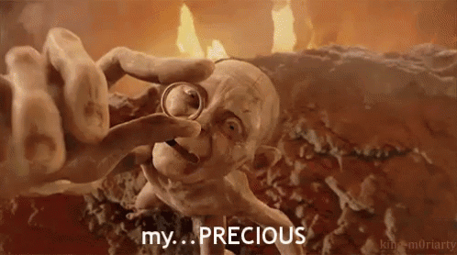
Objectives
List the top 3 characters who are capable of destroying the One Ring
Identify the predominant races of Middle-Earth
Determine which characters are aligned on each side(Justice vs Evil)
Notes:
We have objectives. The first objective is what are the most predominant races in the middle earth. The second one is who belongs to the same side(The divided two sides are justice and evil) The last objective is find out top 3 characters who has the potential to destroy the ring.

Slide 7
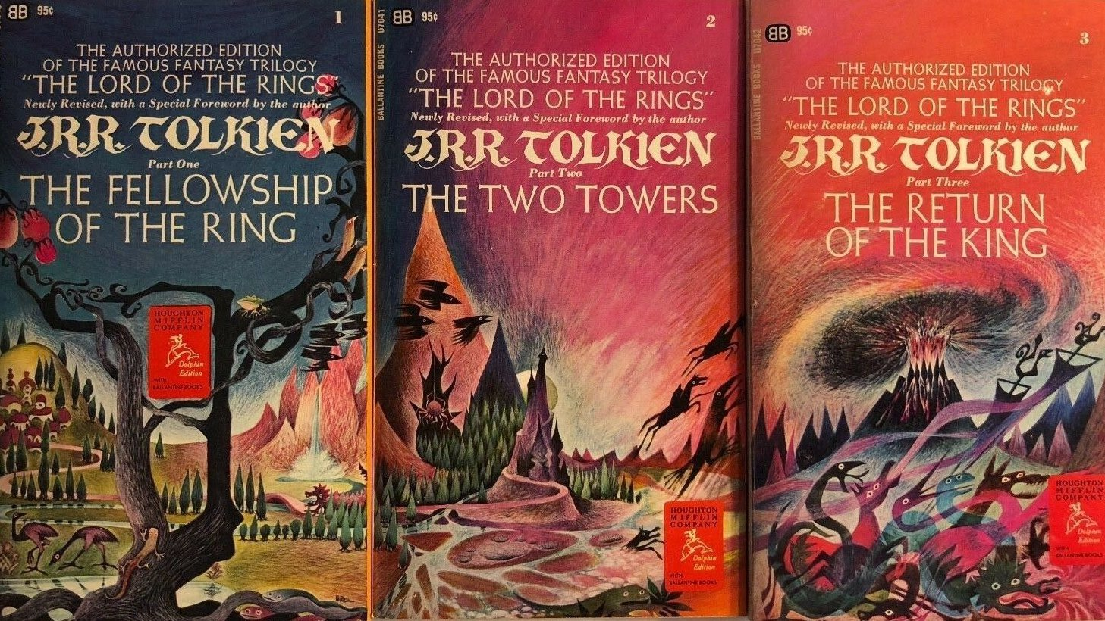
Dataset Description
02
Books
Three books by J.R.R Tolkien from Internet Archive
Book 1 - The Fellowship of the Ring
Book 2 - The Two Towers
Book 3 - The Return of the King
Movie scripts
Movie scripts from the LOTR trilogy
Fan wiki of LOTR
Character names, aliases and races web
scrapped from wiki pages
Notes:
It contains two CSV data sets related to The Lord of the Rings: one containing the scripts from the movies, and the other one with information about the characters of the trilogy (gender, height, race, etc.).It also involves lexicons for sentiment analysis. need to update books and data cleaning

Slide 8
Approach
03
Exploratory Network Analysis
Uncover the interconnectedness of characters to find the right approach for objectives
Who belongs to which side(Justice vs. Evil)?
What are the predominant races in the middle-earth?
Sentiment Analysis
Community Detection
Social Influence
Who are the top three characters with the potential to destroy the One Ring?

Slide 9
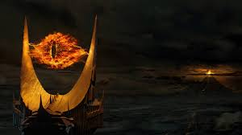
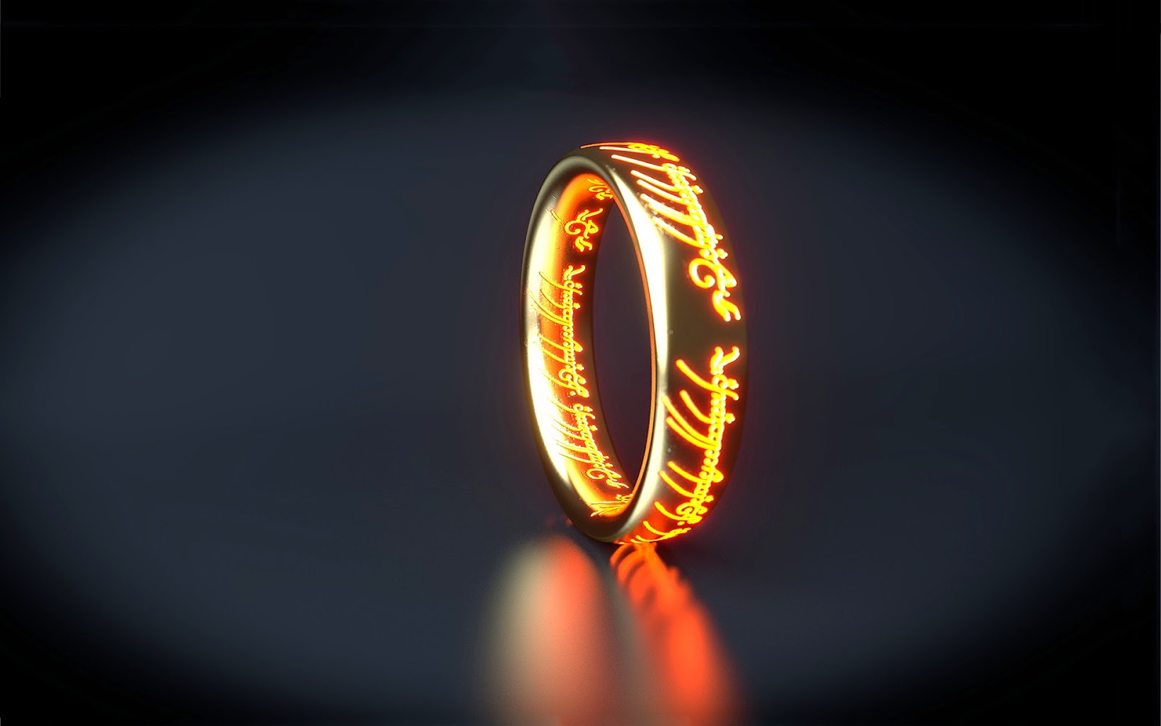
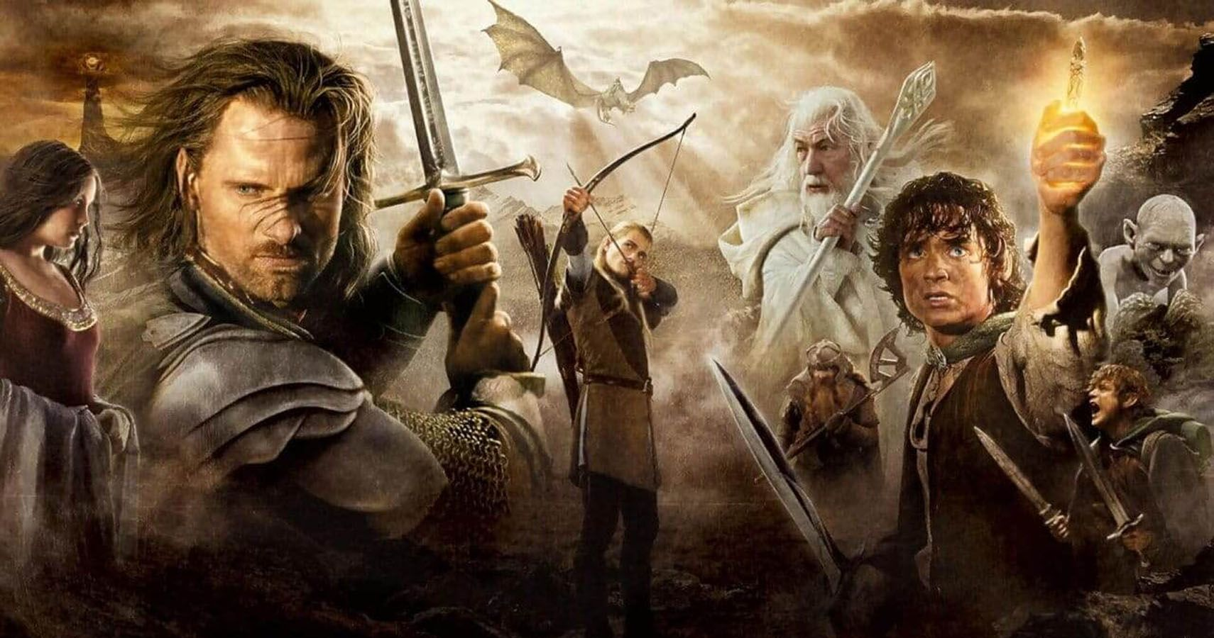
Exploratory Network Analysis

Slide 10
Data Preprocessing
Web scraping Fan Wiki
Clean Books
Nodes and Edges Identification
Clean and combine all the chapters of three volumes of the books
Two Characters present within a chapter have link between them and thus treated as an edge.
Character names, aliases and their races are scrapped from Fan wiki pages
Characters as nodes
Weight Calculation
Using both main name and their aliases to get accurate interaction
Add up character interactions across all chapters to get weight
Notes:
If two characters are in the same chapter it means that they are connected, so there is a link between them

Slide 11
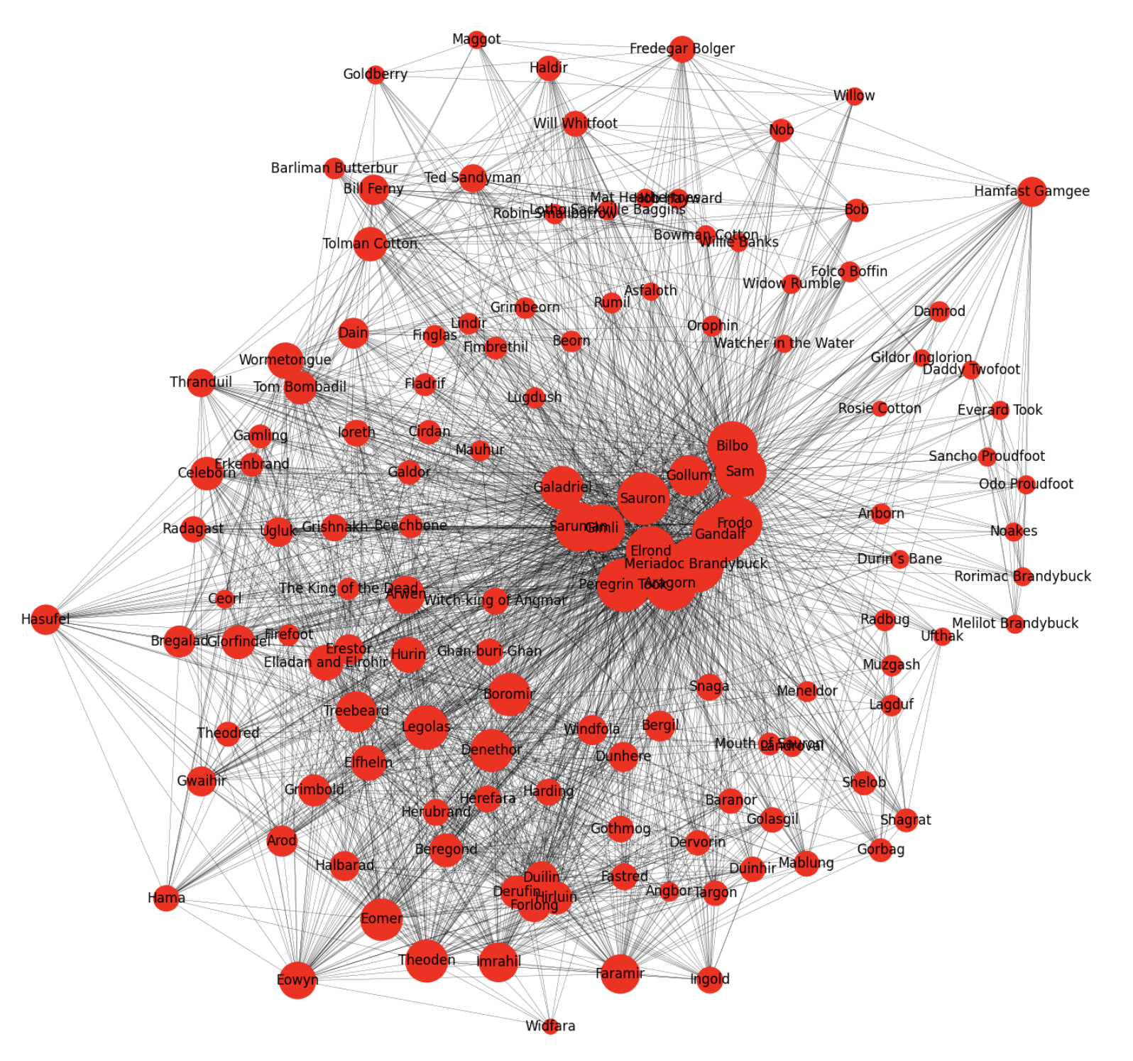
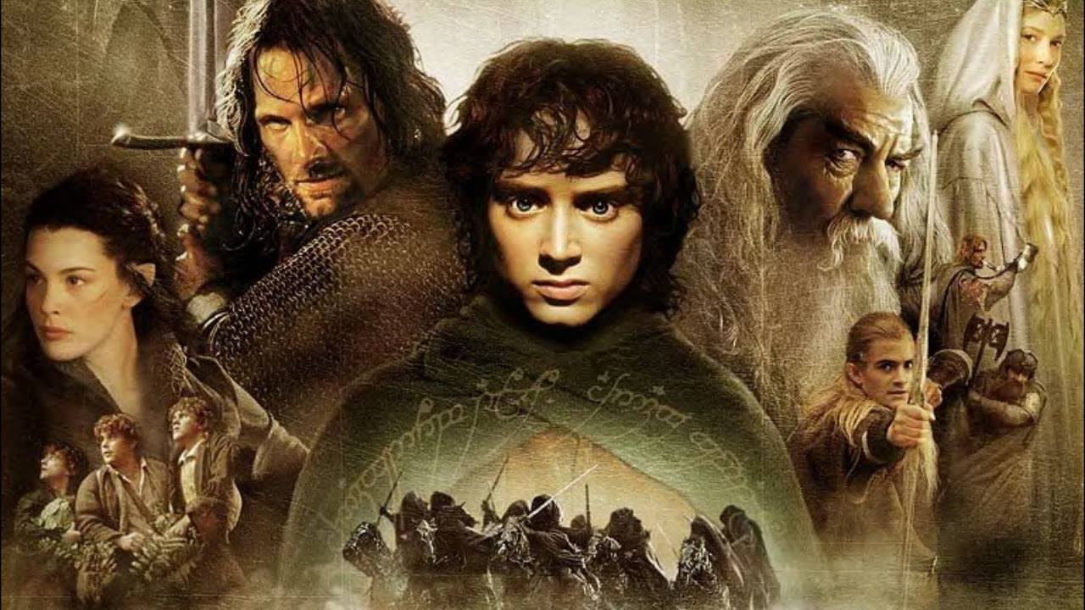
Network Visualization & EDA
Undirected and weighted graph
Number of nodes: 133 Number of edges: 2315
Average node degree:34.8120
Network diameter Diameter (avg): 1.74 Diameter (max): 3.00 Diameter (90th): 2.00
Notes:
We see that we have high degree and low network diameter which signifies that we indeed have a social network

Slide 12
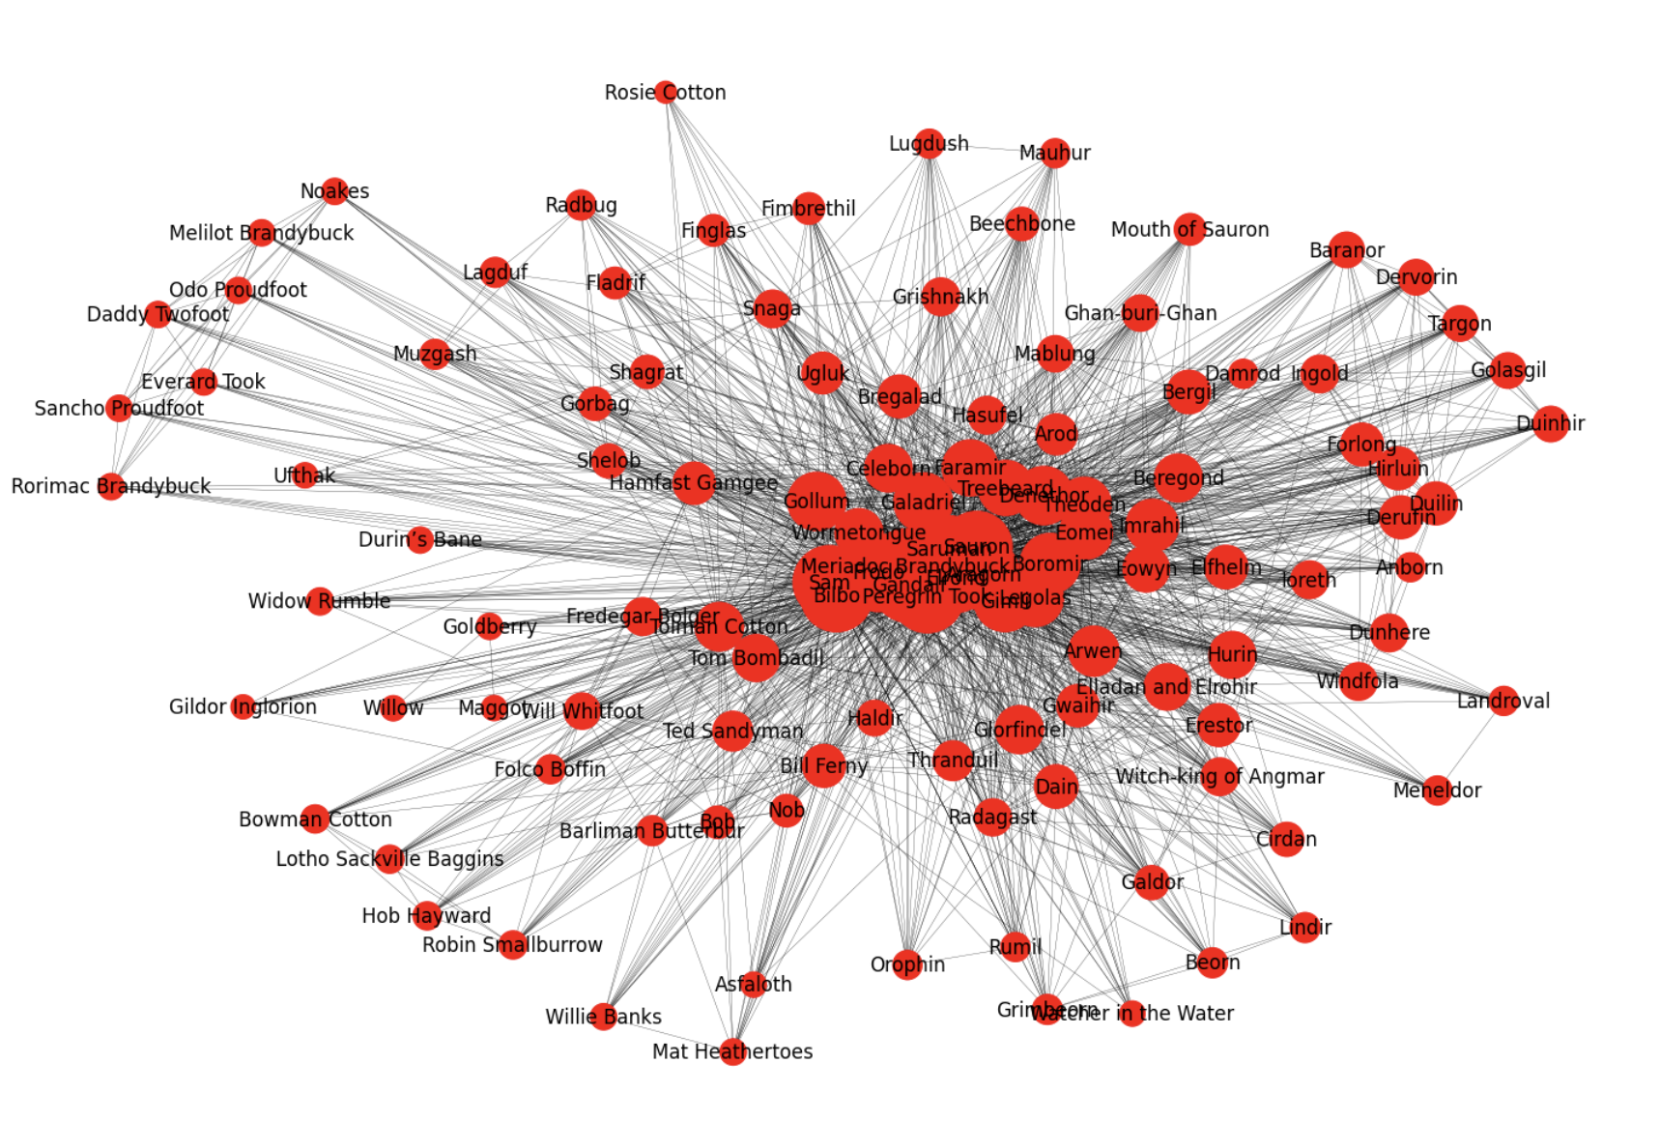
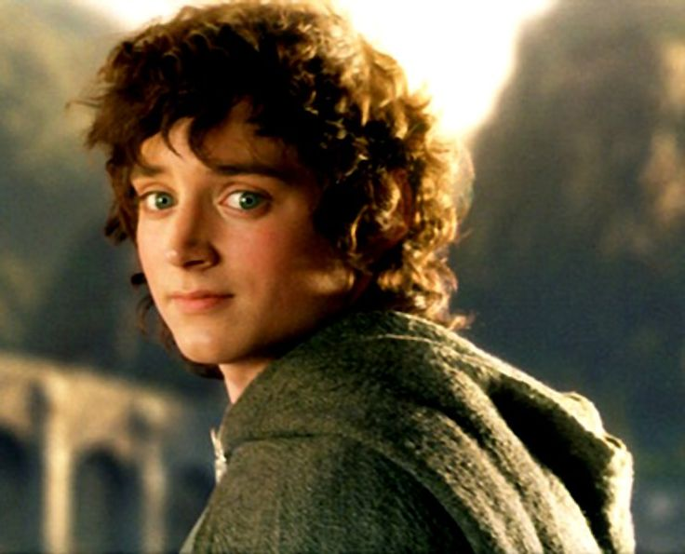
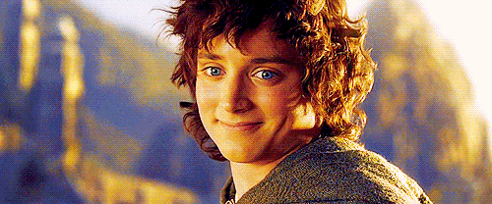
EGO NETWORKS
Frodo (Ring Bearer)
Number of nodes: 117 Number of edges: 1983 Average node degree: 33.89

Slide 13
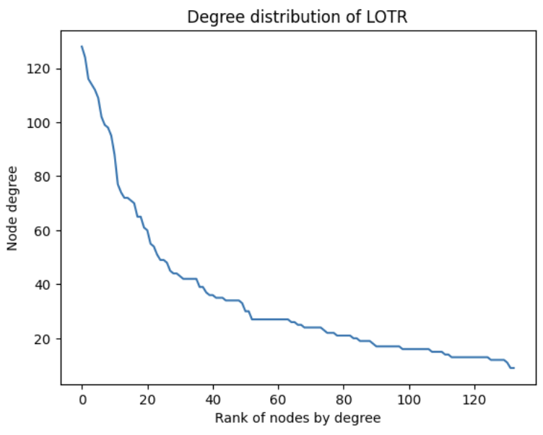
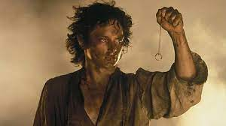
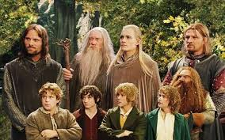
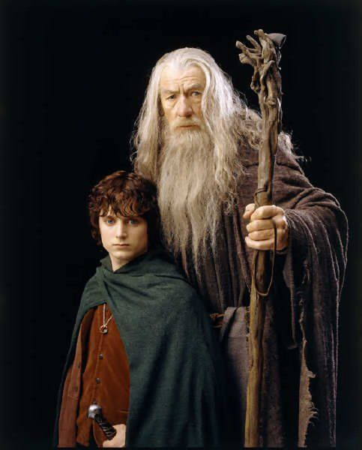
Follows Power law distribution approximately
Degree Distribution
Clustering coefficient
Network has a relatively high clustering co-efficient.
In the context of LOTR, it means two characters having interactions with a common character, have a 50.3% chance of having interaction themselves. This demonstrates the clustered nature of LOTR graph.
c = 0.503

Slide 14
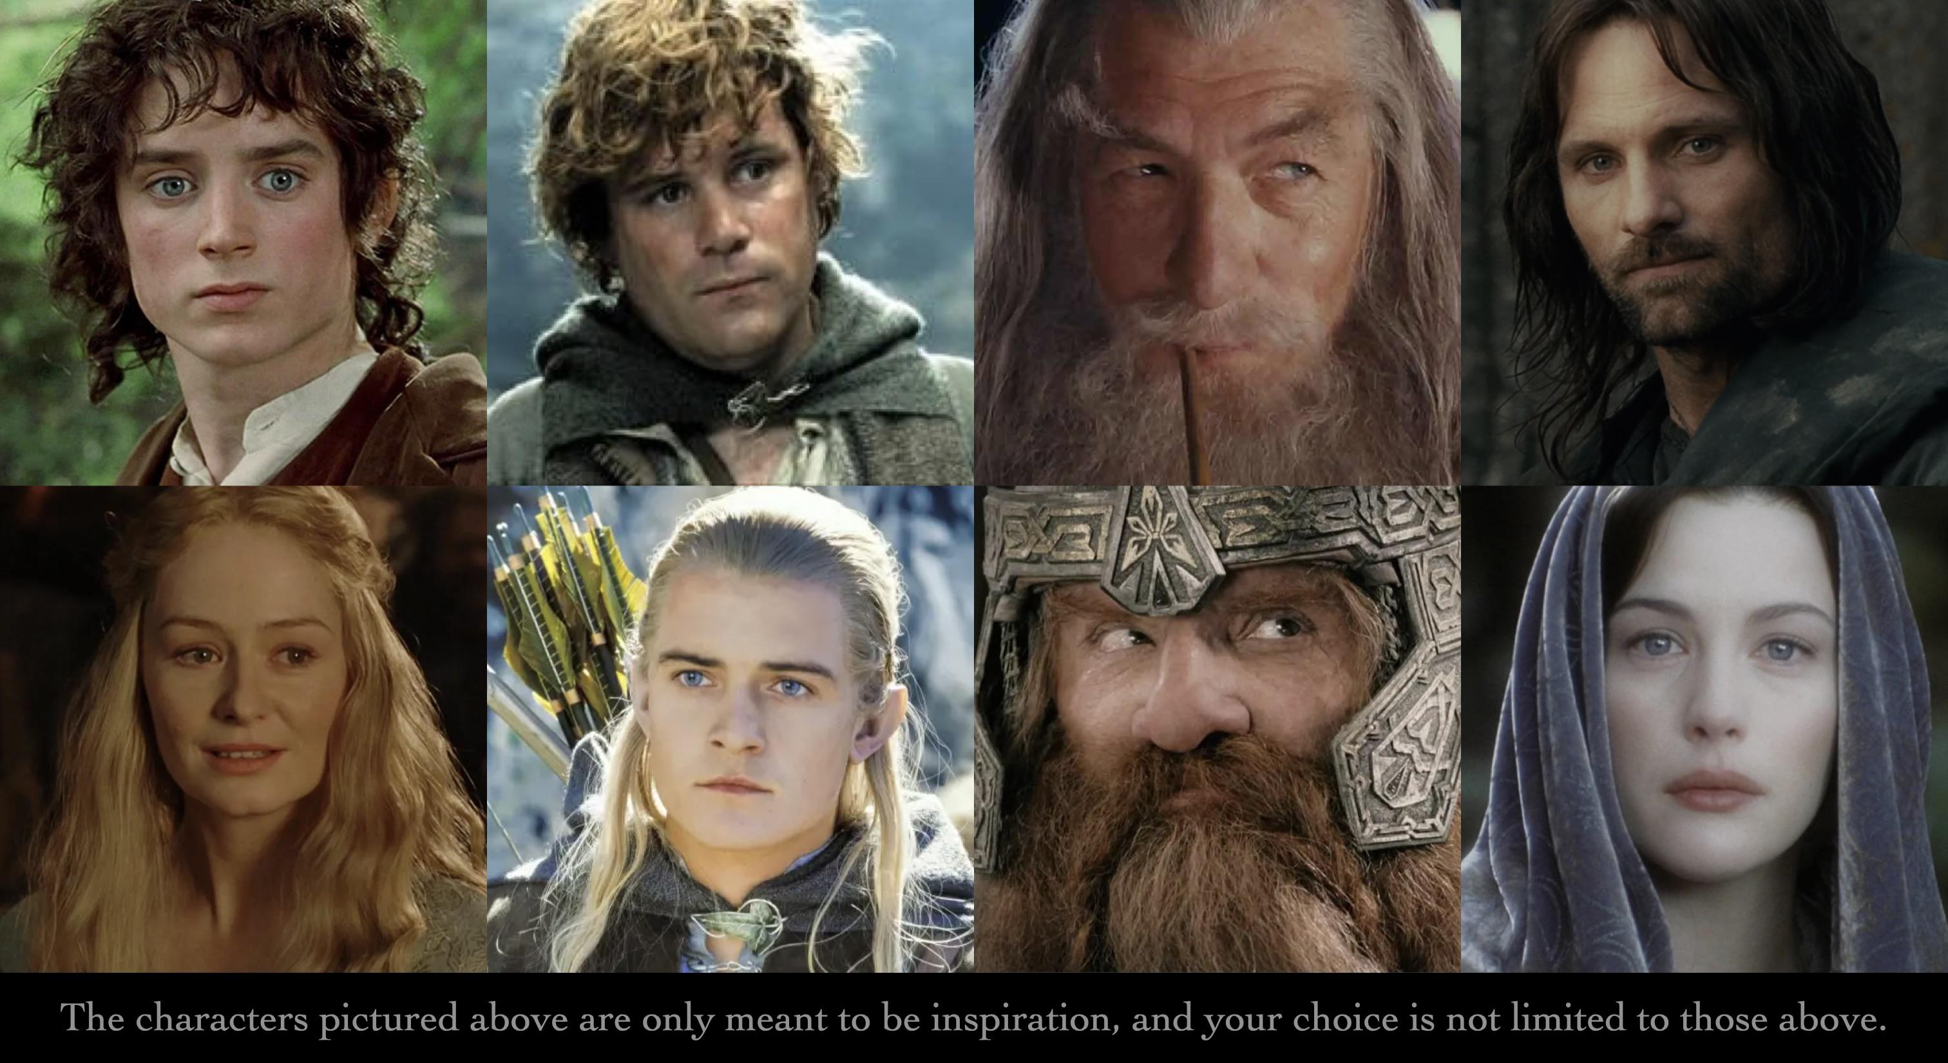
Social Influence
Notes:
It contains two CSV data sets related to The Lord of the Rings: one containing the scripts from the movies, and the other one with information about the characters of the trilogy (gender, height, race, etc.).It also involves lexicons for sentiment analysis.

Slide 15

Who are the most top 3 characters have the potential to destroy the One Ring ? ------Social influence

Slide 16
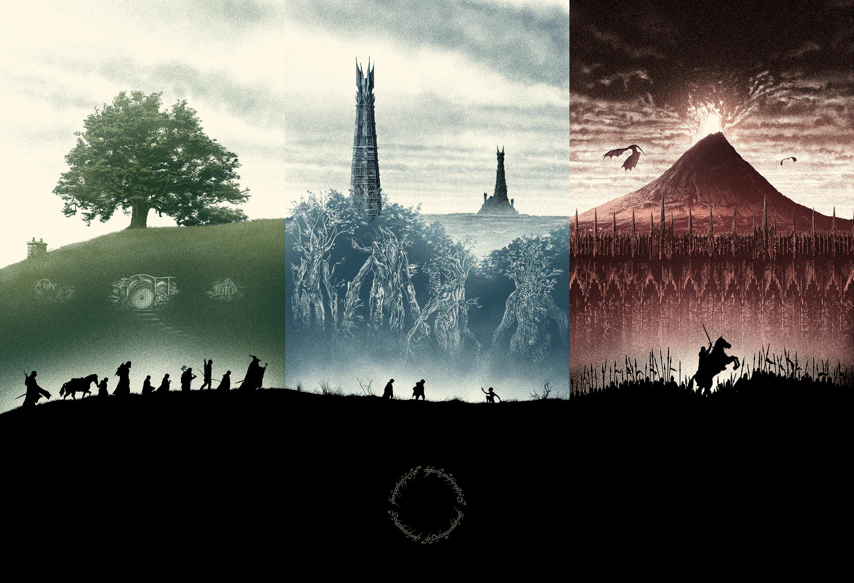
Why we use social influence ?
This is not a question about individual heroism.
The tale is in telling the unity, cooperation, and strategy.
The One Ring----can corrupt and manipulate hearts and minds
Ongoing cooperation among various factions is essential
Network influence measure
Notes:
After we finished watching the movies. We find that if we have to find the characters who has the potential to destroy the one ring, it is not a question about the individual heroism. In the story's world, individual capability is not of primary importance. This is a tale of unity, cooperation, and strategy. Even someone as powerful as Sauron needs the strength and resources of others to achieve his goals. The most significant artifact in the film, the One Ring, has its most terrifying power not in invisibility, but in its ability to corrupt and manipulate hearts and minds. Therefore, the human element is a crucial factor in this story. Before the great battle, alliances must be formed; during the battle, soldiers need to be motivated and morale maintained; and after the battle, ongoing cooperation among various factions is essential. Thus, network influence is the key indicator of whether an individual has the potential to destroy the One Ring.

Slide 17
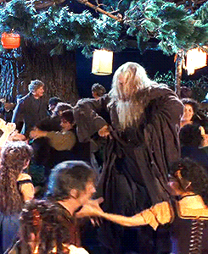
Weighted Centrality Measure
Degree Centrality--10%
Volume rules!
More is better
Betwennness Centrality—20%
Information flow rules
Gate keeper
Normalized Top 10 Degree Centrality: Gandalf: 1.0 Meriadoc Brandybuck: 0.96875 Frodo: 0.90625 Aragorn: 0.890625 Peregrin Took: 0.875 Sauron: 0.8515625 Sam: 0.796875 Bilbo: 0.7734375 Elrond: 0.765625 Saruman: 0.7421875
Normalized Top 10 Betweenness Centrality: Gandalf: 1.0 Meriadoc Brandybuck: 0.9139 Frodo: 0.7203 Peregrin Took: 0.5885 Aragorn: 0.5731 Sam: 0.5269 Sauron: 0.5150 Bilbo: 0.4748 Elrond: 0.3524 Saruman: 0.3375
Notes:
We use 4 kinds of degree centrality measures here, which is degree centrality, betweenness centrality, closeness centrality and eigenvector centrality. you can see here is the first two methods. After creating the social network, we can easily use code to calculate and list the top 10 characters for each method.
In order to get the top 3,I assigned different weights to each centrality measurement. Each character's final score is determined by multiplying their normalized centrality measurement scores by these weights. Based on this algorithm, we can create a comprehensive ranking. The top three positions in this ranking represent the characters with the highest potential to destroy the One Ring.
So let's discribe the method one by one.
Firstly---Degree centrality. This is not as important because it only indicates the number of connections a character has, and while a larger number of connections might suggest greater social abilities, it doesn't tell the full story.
So for Betweenness centrality, it measures the extent to which a node lies on the shortest path between other nodes. Characters with high betweenness centrality can control the flow of information within the network, acting as bridges or gatekeepers. The higher the betweenness, the more easily these characters can influence communication and interaction between different parts of the network, making them crucial for information dissemination and connectivity.

Slide 18
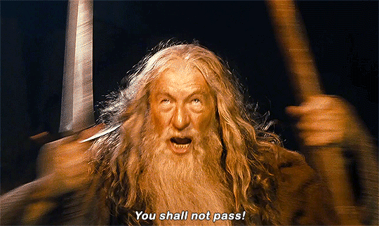
Weighted Centrality Measure
Closeness Centrality—30%
Diffusion speed rules
Friend circle rules!
Your importance is determined by your friends’ importance
Eigenvector Centrality—40%
Normalized Top 10 Closeness Centrality: Gandalf: 0.9705 Meriadoc Brandybuck: 0.9428 Frodo: 0.8918 Aragorn: 0.8800 Peregrin Took: 0.86849 Sauron: 0.8516 Sam: 0.8148 Bilbo: 0.8000 Elrond: 0.7951 Saruman: 0.7810
Normalized Top 10 Eigenvector Centrality: Gandalf: 1.0 Meriadoc Brandybuck: 0.98062 Aragorn: 0.9627 Sauron: 0.93486 Peregrin Took: 0.9307 Frodo: 0.92191 Elrond: 0.8783 Saruman: 0.8611 Gimli: 0.8279 Sam: 0.8181
Notes:
And next for the two of the most pivotal elements.
Closeness centrality is based on how quickly a node can reach all other nodes in the network. It is calculated as the inverse of the sum of the shortest path distances from a node to all other nodes. Characters with high closeness centrality can spread information more efficiently because they are closer to all other characters in terms of path length. In Middle-earth, the key to victory lies in the rapid dissemination of information to garner more allies and quicker support. This is a critical measurement, so I give it a 30% weight.
Eigenvector centrality goes beyond simply counting the number of connections a node has. Instead, it considers the quality of those connections. A character is deemed more important if they are connected to other important characters. This measure accounts for the influence of a character's neighbors and their connections, meaning the character’s influence is amplified if they are connected to other influential people. If betweenness measures how quickly a character can affect others, eigenvector centrality measures how effectively they can do so. It implies that the character’s neighbors are more like the "celebrities" in social networks, potentially leading their groups. The easier it is to reach these key individuals, the more power one can wield and become more competitive during war. It is more crucial than closeness because it enhances effectiveness, so I give it a 40% weight.

Slide 19
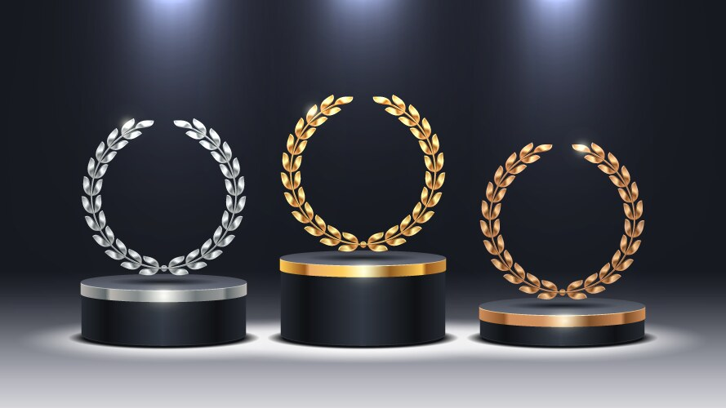
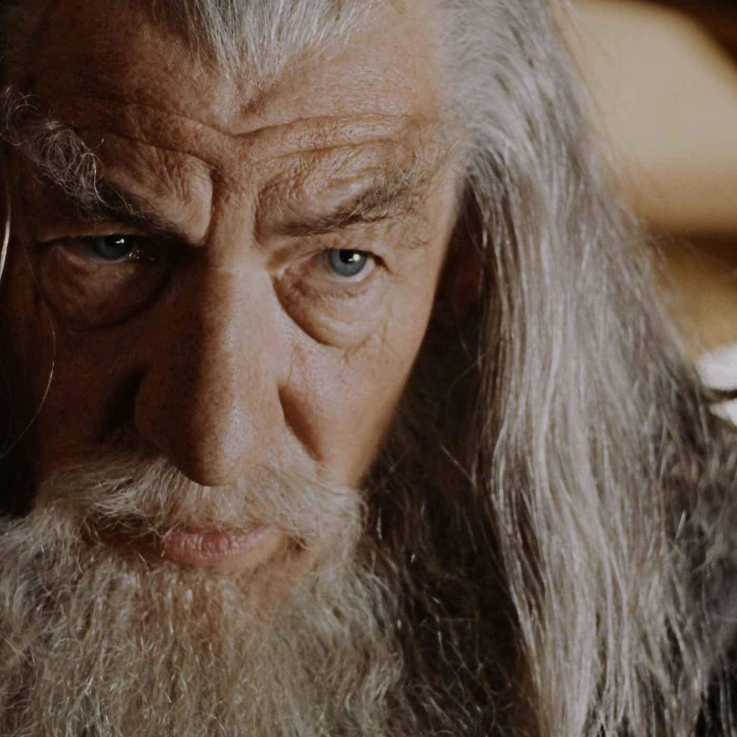
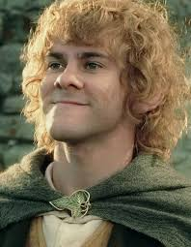
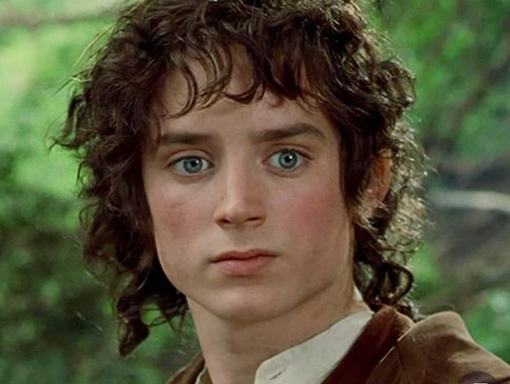
Based on Weighted Centrality Measures we list the top 3 characters who has the potential to destroy the One Ring :
Gandalf
0.9912
Meriadoc Brandybuck: 0.9548​ ​
Frodo
0.8711
Notes:
Based on our weighted centrality measures, we identified the top three characters with the potential to destroy the One Ring:
Gandalf (0.9912):
Gandalf, the wise and powerful wizard, tops our list. His extensive connections, strategic position as a bridge between various factions, and significant influence within the network make him the strongest candidate.
Meriadoc Brandybuck (0.9548):
Merry, one of the courageous Hobbits, ranks second. His ability to connect with key characters and facilitate communication within the Fellowship and beyond highlights his critical role in the quest.
Frodo Baggins (0.8711):
Frodo, the ring-bearer, comes in third. Despite his relatively fewer connections, his close proximity to crucial characters and his direct involvement in the mission to destroy the One Ring underline his importance.
We can see that two of the top three characters are Hobbits, and one is the actual ring-bearer. Although the ring-bearer is ranked third, this still demonstrates the reliability of our results. Hobbits, who are naturally small and seemingly the least capable in battle, possess the purest hearts and the most steadfast characters due to their simple, peaceful lifestyle and lack of worldly desires. This inherent purity and resilience earn them the respect of others and enable them to win people's hearts, explaining why their social influence scores are so high. This quality is at the core of this tale.
In conclusion, our analysis using weighted centrality measures provides a comprehensive ranking of characters based on their potential to destroy the One Ring. Gandalf, Merry, and Frodo emerge as the top three candidates due to their significant social influence, strategic positions, and leadership qualities. This approach not only highlights the importance of unity and cooperation but also underscores the critical role of social networks in achieving monumental tasks in Middle-earth.

Slide 20
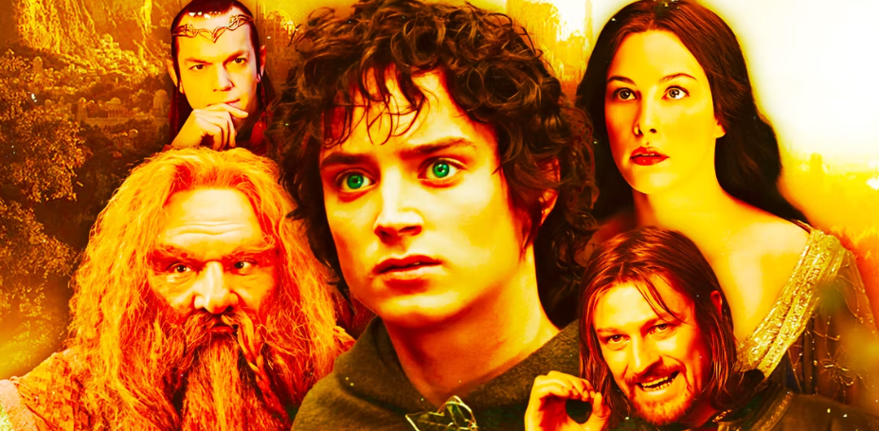
Community Detection
Notes:
Lets dicuss about the community detection and find the different communities in middle earth. Community detection helps us to further perform sentiment analysis based on the distribution of characters among communties.

Slide 21
What are the predominant races in middle earth ------Community Detection
Notes:
The main objective of community detection is to find the predominant races in the middle earth which is one of the three objectives we proposed.

Slide 22
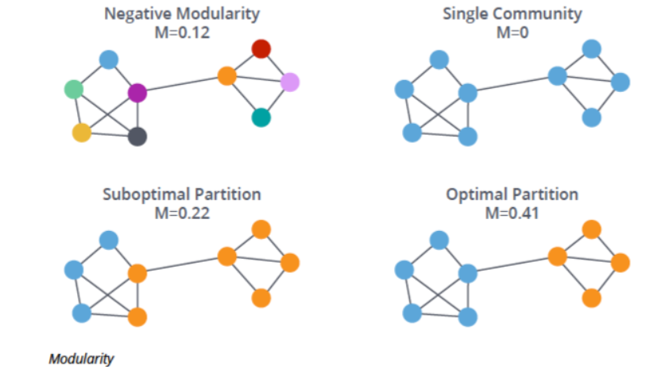
Methodology
Louvain community detection algorithm
Step 1 : Every node remains in its same community
Step 2 : Find maximum positive modularity gain for each node
Positive gain achieved : node shifts to that particular community.
No positive gain : Node remains in the same community

Slide 23
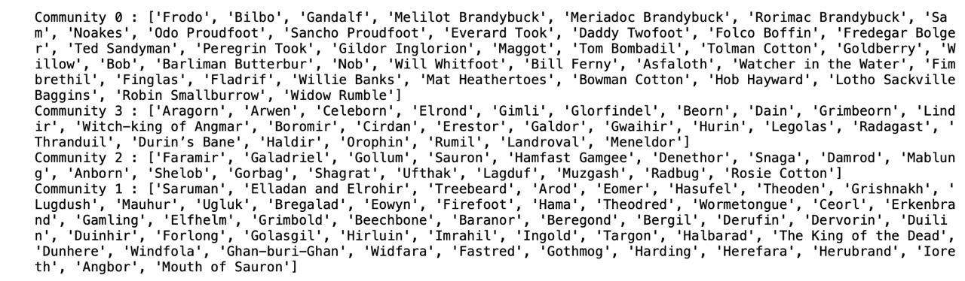
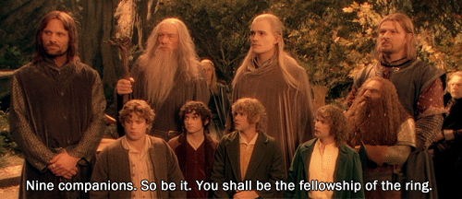
Community Classification Based on Characters
Based on Louvain method we have four clusters 0,1,2,3
Objective 1 : Create the confusion matrix with the distribution of races to find the predominant race
Objective 2 : Further perform sentiment analysis to find sentiment of the communities
Notes:
We've detected four clusters, labeled 0, 1, 2, and 3."
"Objective 1: Create a confusion matrix showing the distribution of races in each cluster to find the predominant race."
"This matrix helps identify the dominant race within each community."
"Objective 2: Perform sentiment analysis to determine the emotional tone (positive, negative, or neutral) of each cluster."
"By examining sentiments, we can gauge the general mood and attitudes of the communities."
"Combining race distribution with sentiment analysis provides a comprehensive view of community dynamics."
"This dual analysis helps in understanding both demographic and emotional aspects of each community."

Slide 24
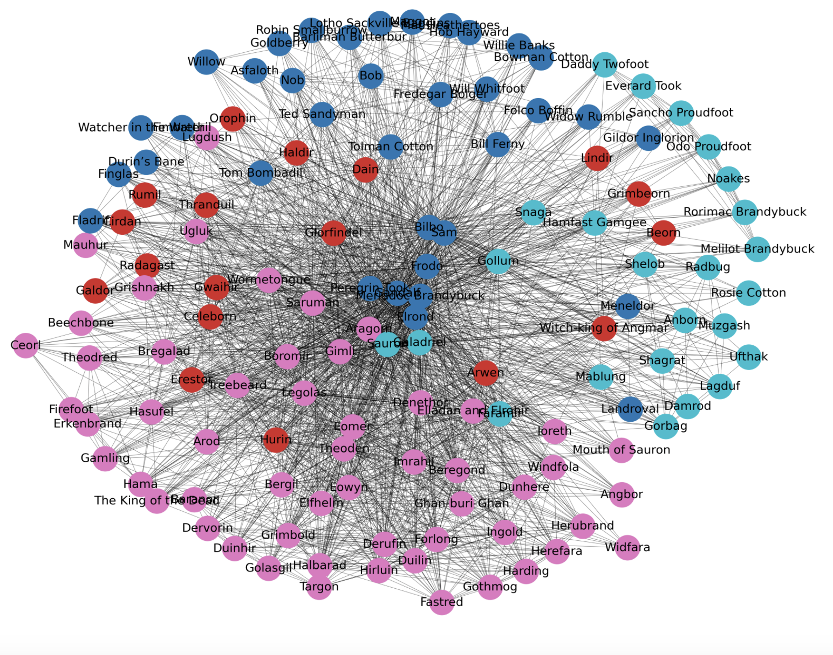
Community Network Visualization
COMMUNITY 0 :
COMMUNITY 1 :
COMMUNITY 2 :
COMMUNITY 3 :
Notes:
Here, we are analyzing the races and communities of "The Lord of the Rings" by visualizing them through a network visualization graph.

Slide 25
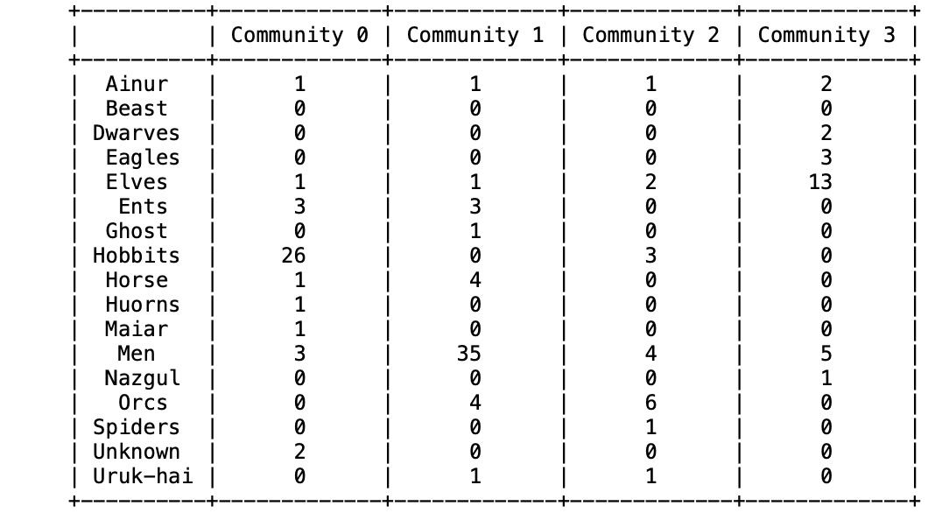
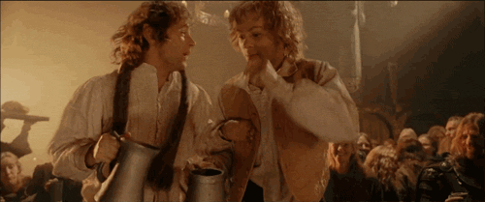
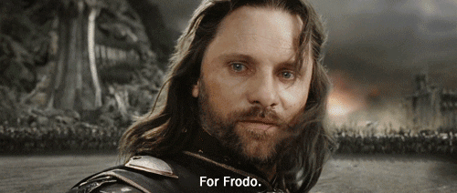
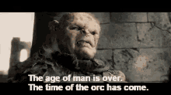
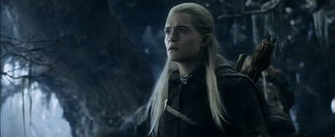
Race distribution and their dominance
PREDOMINANT RACES
COMMUNITY 0 : HOBBITS
COMMUNITY 1 : MEN
COMMUNITY 2 : ORCS
COMMUNITY 3 : ELVES
It can be observed from the matrix table that Hobbits, men, orcs and Elves are the predominant races which play an important role in the trilogy of Lord of the rings.

Slide 26
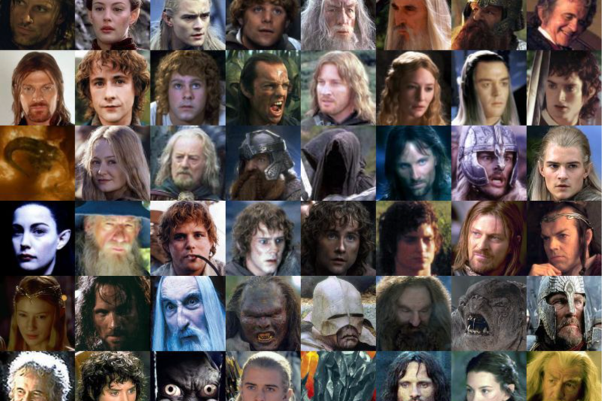
Sentiment Analysis of Characters by Community

Slide 27
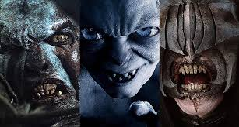
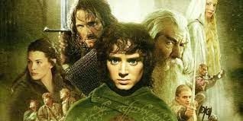


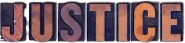
Objective
To analyze the sentiment of characters in "Lord of the Rings" and aggregate the sentiment scores for different communities

Slide 28
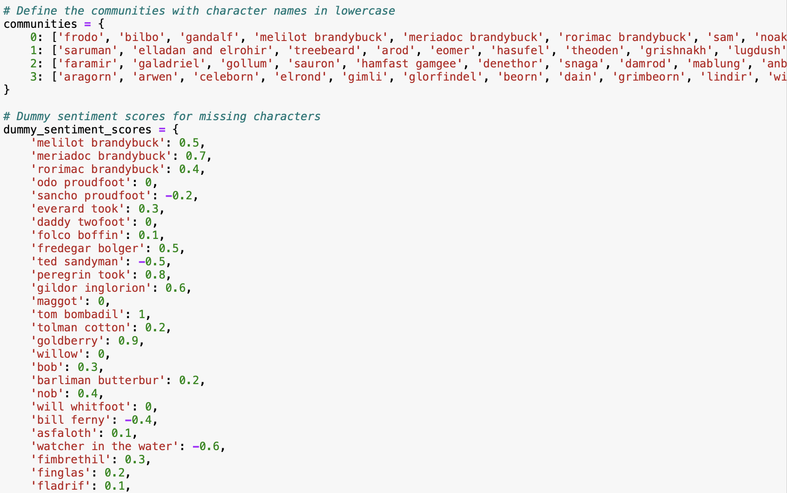
Methodology
Used TextBlob for sentiment analysis：
Sentiment scores range
from -1 (very negative) to
1 (very positive)
Perform sentiment analysis on character dialogues
Aggregate sentiment scores for each community

Slide 29
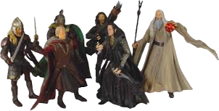
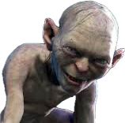
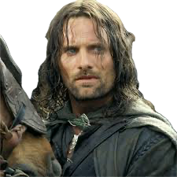
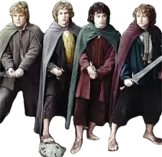
Community Definitions
Tom Bombadil
Wormtongue
Community 0:
Frodo
Bilbo
Gandalf
Meriadoc
Brandybuck
(Merry)
Sam
Peregrin Took (Pippin)
Community 1:
Saruman
Treebeard
Eomer
Theoden
Eowyn
Community 2:
Faramir
Galadriel
Gollum
Sauron
Hamfast Gamgee
Denethor
Community 3:
Aragorn
Arwen
Elrond
Gimli
Legolas
Boromir

Slide 30
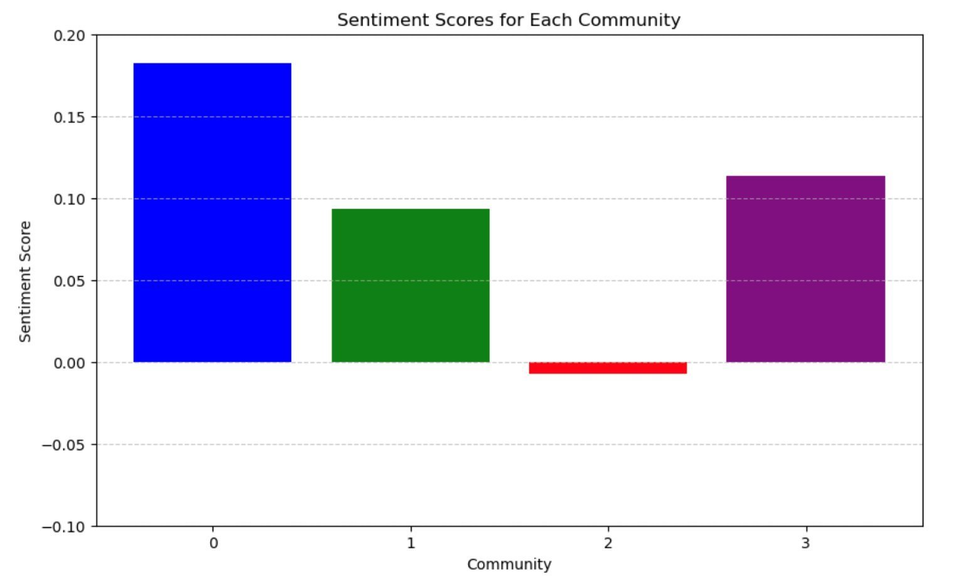
Sentiment Analysis Results
Community 0: 0.182190
Community 1: 0.093218
Community 2: -0.007375
Community 3: 0.113158

Slide 31
Reference
04
Kaggle Analysis: Vivancos, X. (n.d.). Analyzing the Lord of the Rings data. Retrieved from https://www.kaggle.com/code/xvivancos/analyzing-the-lord-of-the-rings-data
LOTR Wiki:LOTR Fandom. (n.d.). Main Page. Retrieved from https://lotr.fandom.com/wiki/Main_Page
The Books on Archive.org: Archive.org. (n.d.). The Lord of the Rings. Retrieved from https://archive.org
Nab-88. (n.d.). Lord of The Rings - Project. Retrieved from https://nab-88.github.io/social-graphs-and-interactions/
Notes:
It contains two CSV data sets related to The Lord of the Rings: one containing the scripts from the movies, and the other one with information about the characters of the trilogy (gender, height, race, etc.).It also involves lexicons for sentiment analysis.

Slide 32
Project Reflection
Team Contributions:
1. Huyu: Spearheaded the sentiment analysis, providing crucial insights into character emotions and their narrative significance. Contributed significantly to the final report and presentation.
2. Kruti: Managed the exploratory data analysis, uncovering key patterns and insights through sophisticated visualizations. Played a vital role in data preparation and presentation crafting.
3. Ilan: Led the community detection efforts, applying complex algorithms to elucidate the hidden structures within the character networks. His work was instrumental in segmenting the data for more targeted analysis.
4. JunYi: Focused on analyzing social similarities, identifying pivotal relationships that influence the storyline. His analytical prowess helped align our findings with the overarching project themes.

Slide 33
Project Reflection
Technical Reflection:
1. Challenges Encountered: We faced significant challenges in handling and cleaning the extensive datasets. Implementing advanced network analysis techniques required meticulous attention to detail to accurately model the complex interactions within Middle-earth.
2. Technical Achievements: Successfully integrating multiple analytical methods (network analysis, sentiment analysis, community detection) showcased our ability to handle complex, interdisciplinary tasks. Our approach allowed us to draw profound insights into the social dynamics of Tolkien’s world.
Non-Technical Reflection:
1. Team Collaboration: Despite differing time zones and academic backgrounds, our team maintained effective communication throughout the project. Regular meetings and agile adjustments to our workflow were pivotal.
2. Skills Developed: Beyond analytical skills, this project honed our abilities in project management and collaborative problem solving, teaching us the importance of adaptability and thorough planning.

Slide 34
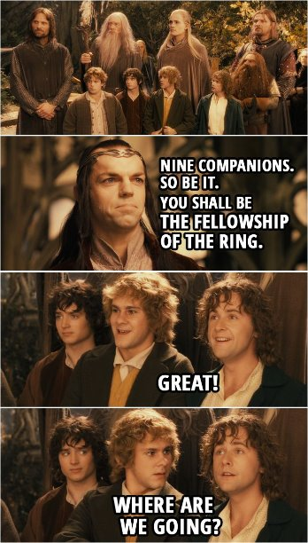
Thank You!

